Slide 1
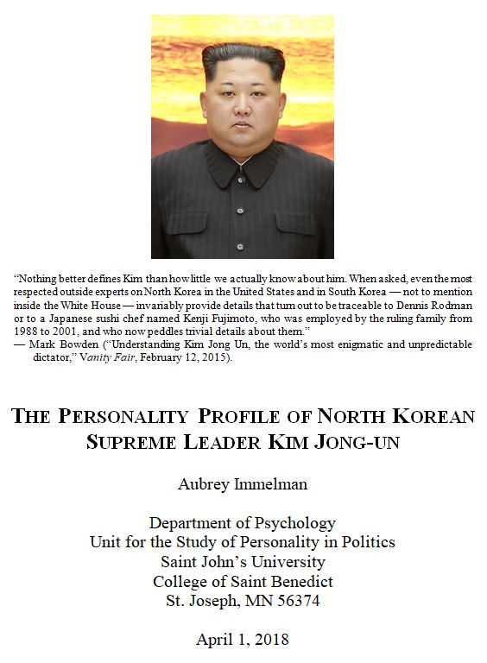
Notes:
The Personality Profile of North Korean Supreme Leader Kim Jong Un
Working paper by Aubrey Immelman, Unit for the Study of Personality in Politics, St. John’s University and the College of St. Benedict, Collegeville and St. Joseph, Minn., April 1, 2018. Abstract and full text available for download at Digital Commons: https://digitalcommons.csbsju.edu/psychology_pubs/119/

Slide 2
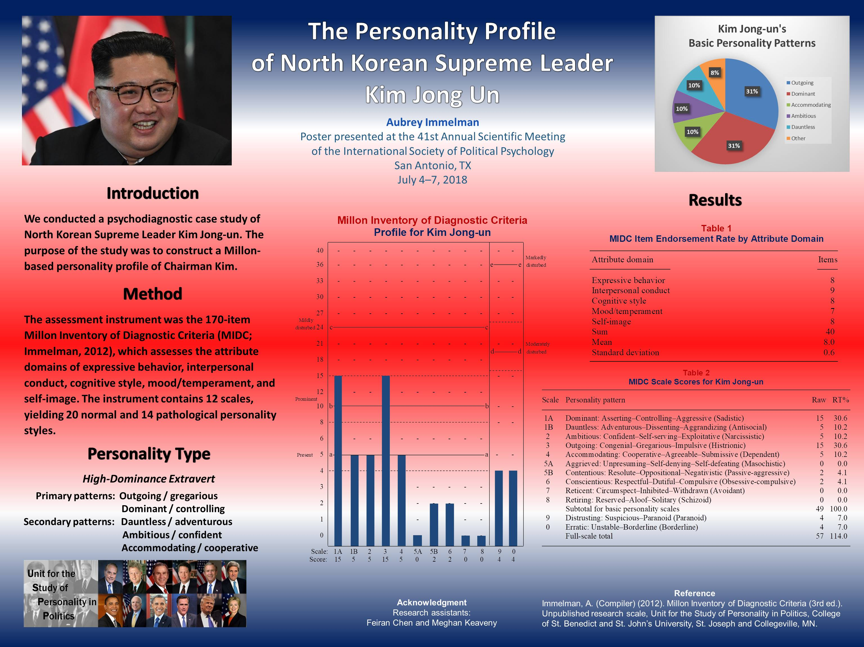
Notes:
The Leadership Style of North Korean Supreme Leader Kim Jong Un
Working paper by Aubrey Immelman, Unit for the Study of Personality in Politics, St. John’s University and the College of St. Benedict, Collegeville and St. Joseph, Minn., June 10, 2018. Abstract and full text available for download at Digital Commons: https://digitalcommons.csbsju.edu/psychology_pubs/120/

Slide 3
The Personality Profile of Kim Jong Un
Abstract
Kim Jong-un’s primary personality patterns are Outgoing/gregarious (extraverted) and Dominant/controlling (assertive), supplemented by secondary Accommodating/cooperative (conciliatory) Ambitious/confident (narcissistic), and Dauntless/adventurous (unconventional) features. Based on his Outgoing–Dominant primary personality composite, Kim may be classified as a high-dominance extravert.
Outgoing individuals are dramatic attention‑getters who thrive on being the center of social events, go out of their way to be popular with others, and are confident in their social skills; they may have an impulsive tendency and be prone to boredom. Dominant individuals enjoy the power to direct others and to evoke obedience and respect; they can be tough and unsentimental and often make effective leaders. Accommodating individuals are notably cordial, cooperative, and amicable; they are willing to adapt their preferences to be compatible with those of others, to reconcile differences to achieve peaceable solutions, and to concede or compromise when necessary. Ambitious individuals are bold, competitive, and self-assured; they easily assume leadership roles, expect others to recognize their special qualities, and may act as though entitled. Dauntless individuals tend to flout tradition, conventional standards, and cultural mores, dislike following routine, and may act impulsively and recklessly; they are resistant to coercion and may exhibit a strong need for autonomy and self-determination.
Kim Jong-un’s major personality-based leadership strength is a distinctly outgoing tendency, supplemented by an accommodating inclination, a fitting descriptive label for which would be congenial–cooperative. Leaders possessing this personal quality can be expected to be jovial, socially gregarious, agreeable, accommodating, and obliging in their relationships with others; they are characteristically gracious, neighborly, and benevolent, pre­ferring to avoid conflict and seek harmony with others. These attributes could serve North Korea well with respect to greater openness in the international arena.

Slide 4
Definition of Personality
Distinctive, pervasive patterns of thinking, feeling, acting, and relating to others
Stable over time
Consistent across situations

Slide 5
Nature of Personality
Deeply embedded (ingrained)
Largely nonconscious
Not easily altered
Expressed automatically in most facets of functioning

Slide 6
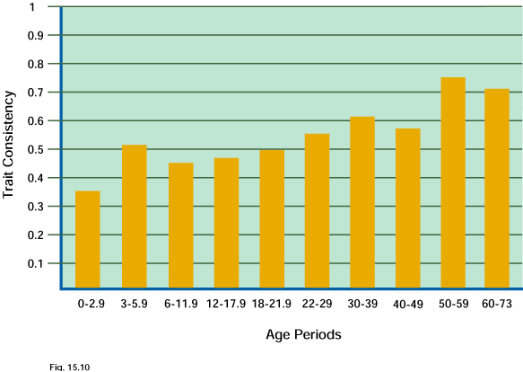
Personality Stability
Consistency over Time
Consistency increases with age
Personality is more consistent over time than across situations
Consistency is weaker for attitudes, interests, and opinions than for personality
Coherence: Although temporally consistent, how a trait is manifested in behavior might change over time

Slide 7
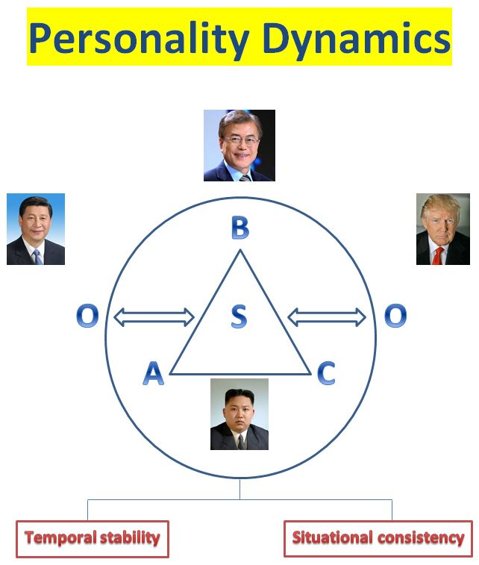
Notes:
Psychology is the study of behavior (B) and mental processes (Cognition and Affect)
Personality refers to the temporally stable and cross-situationally consistent ways people (S) think (C), act (B), feel (A), and relate to others (O)
A = Affect (MIDC attribute D: Mood/Temperament)
B = Behavior (MIDC attribute A: Expressive behavior)
C = Cognition (MIDC attribute C: Cognitive style)
O = Others (MIDC attribute B: Interpersonal conduct)
S = Self (MIDC attribute E: Self-image)

Slide 8
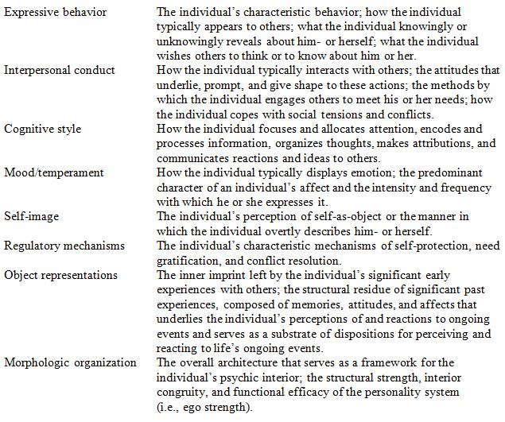
Millon’s Eight Attribute Domains
Notes:
From Disorders of Personality: DSM–IV and Beyond (pp. 141–146) by T. Millon, 1996, New York: Wiley; Toward a New Personology: An Evolutionary Model (chapter 5) by T. Millon, 1990, New York: Wiley; and Personality and Its Disorders: A Biosocial Learning Approach (p. 32) by T. Millon and G. S. Everly, Jr., 1985, New York: Wiley. Copyright © 1996, © 1990, © 1985 by John Wiley & Sons, Inc. Adapted by permission of John Wiley & Sons, Inc. and Theodore Millon.

Slide 9
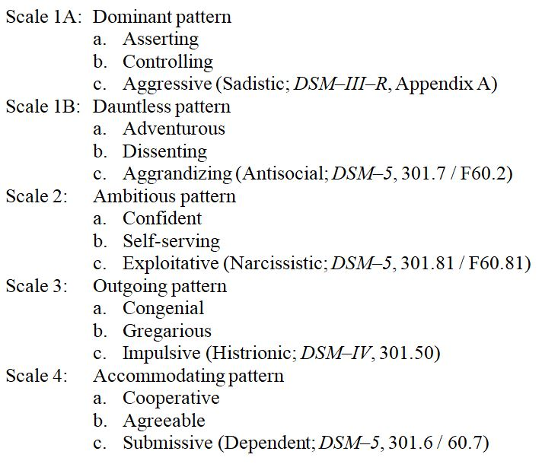
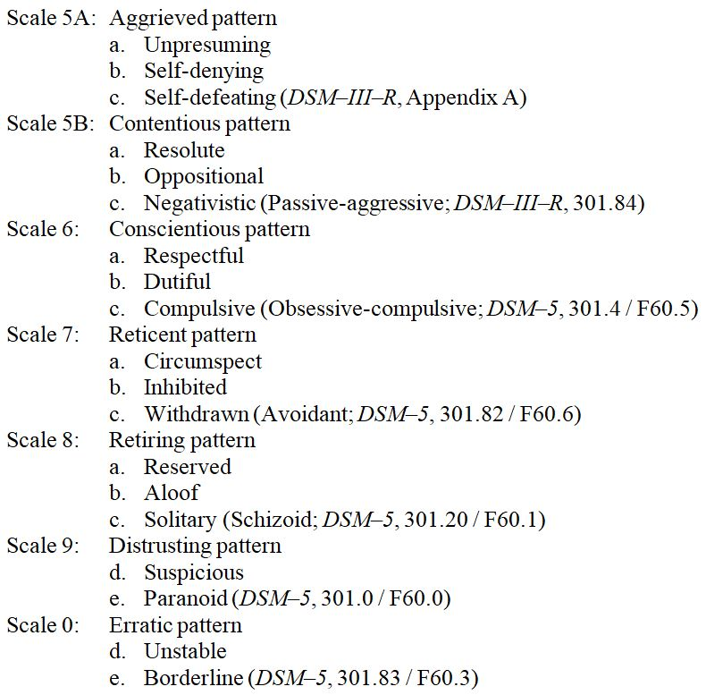
Millon Inventory of Diagnostic Criteria
Taxonomy: Scales and Gradations

Slide 10
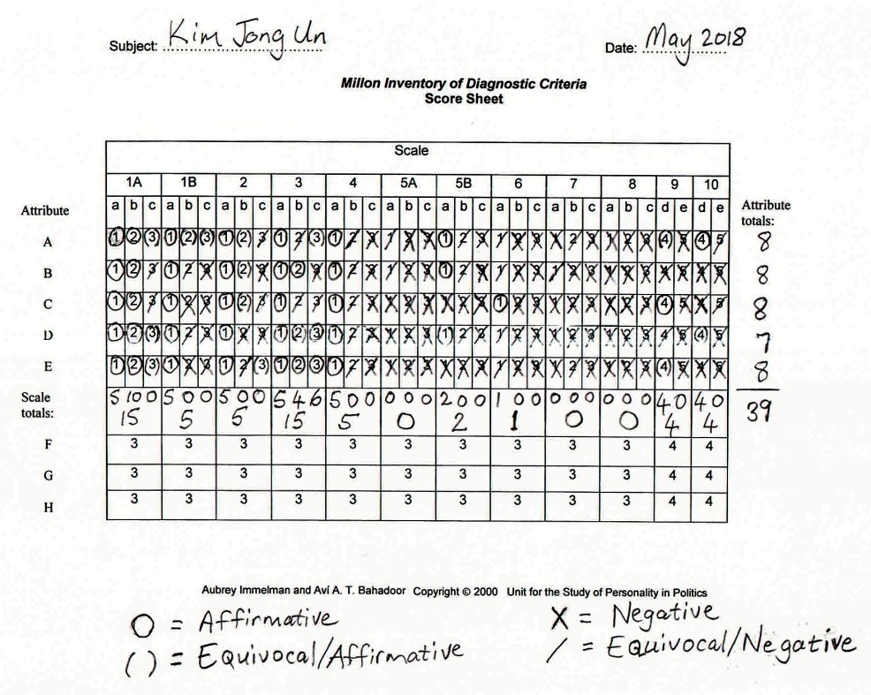
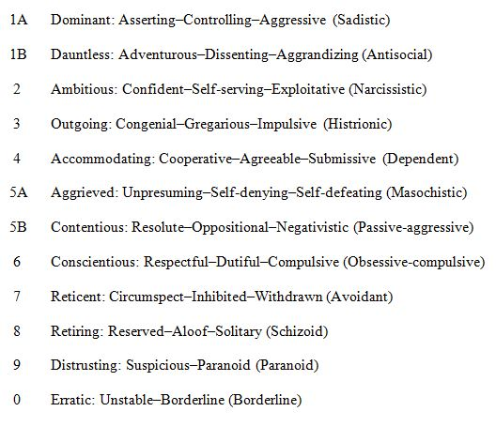
MIDC Score Sheet for Kim Jong-un

Slide 11
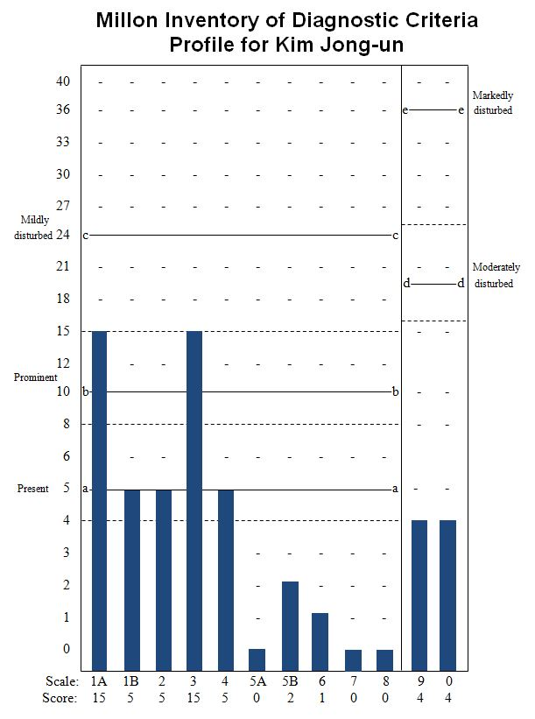
MIDC Profile for Kim Jong-un

Slide 12
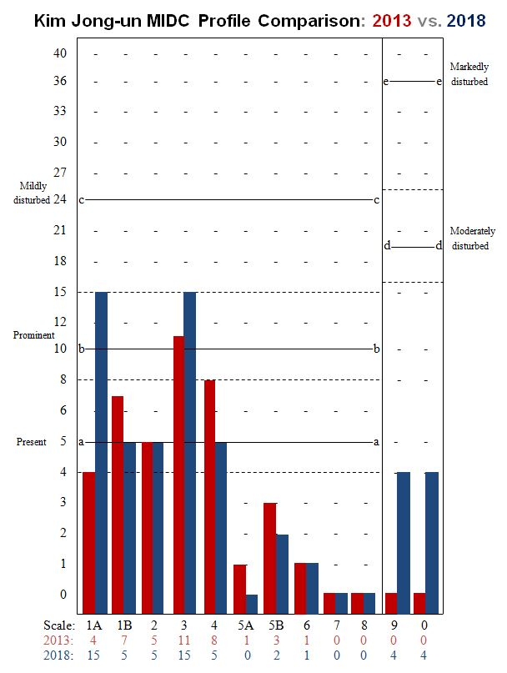
MIDC Profile for Kim Jong-un: 2013 vs. 2018

Slide 13
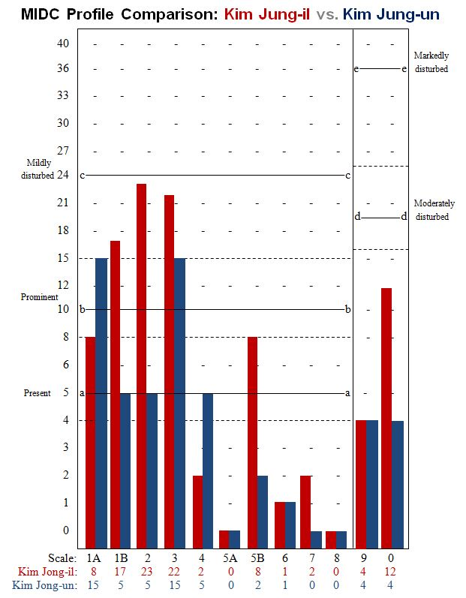
MIDC Profiles Compared: Kim Jong-il vs. Kim Jong-un

Slide 14
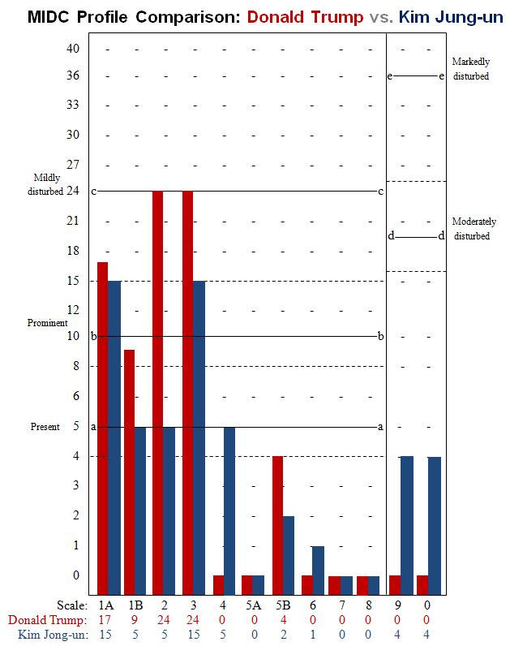
MIDC Profiles Compared: Donald Trump vs. Kim Jong-un

Slide 15
Kim Jong Un
High-Dominance Extravert
Outgoing
Attention‑seeking
Thrive on being the center of social events
Go out of their way to be popular with others
Confident in their social skills
Prone to boredom
Impulsive tendency
Dominant
Enjoy the power to direct others and to evoke respect
Can be tough and unsentimental
Potential for effective leadership

Slide 16
Outgoing–Dominant Composite
High-Dominance Extravert
Primary Personality Patterns
Outgoing/gregarious (Scale 3, level b)
Dominant/controlling (Scale 1A, level b)
Secondary Personality Patterns
Accommodating/cooperative (Scale 4, level a)
Ambitious/confident (Scale 2, level a)
Dauntless/adventurous (Scale 1B, level a)

Slide 17
Personality Profile: Executive Summary
Outgoing types: Dramatic attention‑getters who thrive on being the center of social events, go out of their way to be popular with others, and are confident in their social skills; may have an impulsive tendency and be prone to boredom.
Dominant types: Enjoy the power to direct others and to evoke obedience and respect; can be tough and unsentimental and often make effective leaders.
Accommodating types: Notably cordial, cooperative, and amicable; are willing to adapt their preferences to be compatible with those of others, to reconcile differences to achieve peaceable solutions, and to concede or compromise when necessary.
Ambitious types: Bold, competitive, and self-assured; easily assume leadership roles, expect others to recognize their special qualities, and may act as though entitled.
Dauntless types: Tend to flout tradition, conventional standards, and cultural mores, dislike following routine, and may act impulsively and recklessly; resistant to coercion and may exhibit a strong need for autonomy and self-determination.

Slide 18
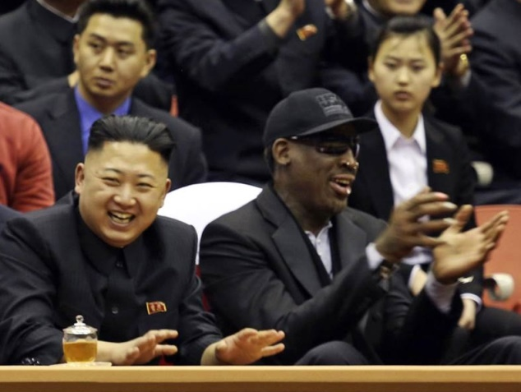
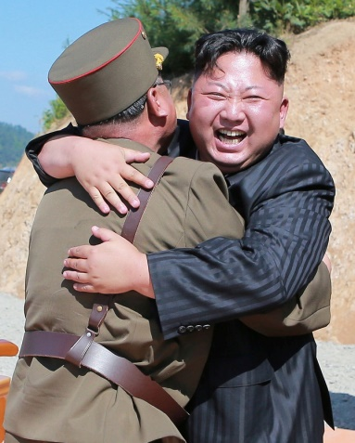
Outgoing/gregarious
Dramatic attention‑getters who thrive on being the center of social events, go out of their way to be popular with others, and are confident in their social skills; may have an impulsive tendency and be prone to boredom.
Notes:
North Korean leader Kim Jong Un and former NBA star Dennis Rodman watch an exhibition basketball game in Pyongyang, North Korea, on Feb. 28, 2013 (VICE via Reuters)
North Korean leader Kim Jong Un reacts with scientists and technicians of the DPRK Academy of Defense Science after the test-launch of the intercontinental ballistic missile Hwasong-14, July 4, 2017. (Korean Central News Agency)

Slide 19
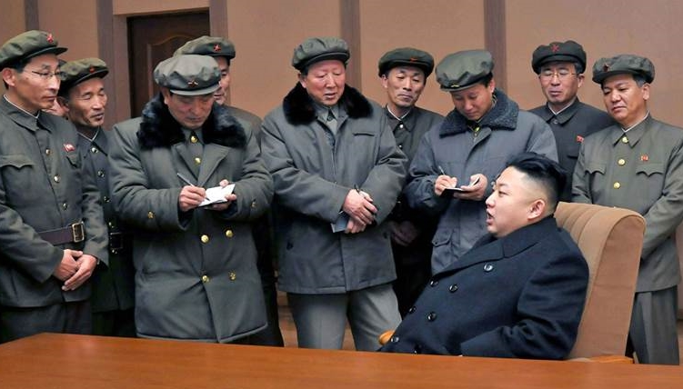
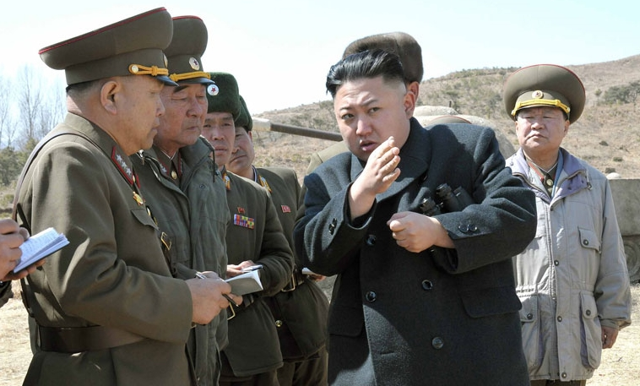
Dominant/controlling
Enjoy the power to direct others and to evoke obedience and respect; can be tough and unsentimental and often make effective leaders.
Notes:
North Korean leader Kim Jong Un visits the West Sea Satellite Launch Site in Cholsan County where the North launched the Unha-3 (Milky Way 3) rocket carrying the second version of Kwangmyongsong-3 satellite, Dec. 15, 2012. (KCNA via Reuters)
State media says North Korea's leader, Kim Jong-un, signed a rocket preparation plan and ordered rockets on standby to strike not only the U.S. mainland, but South Korea, Guam, and Hawaii, March 2013. (KCNA via Reuters)

Slide 20
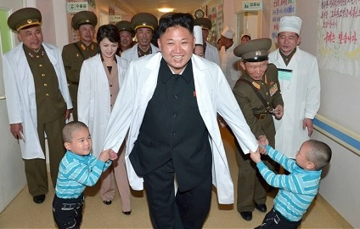
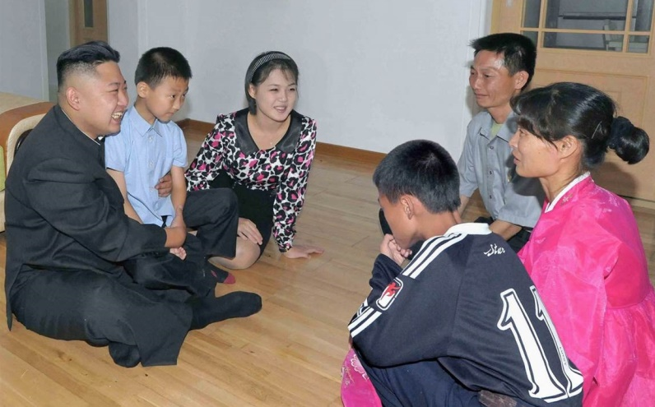
Accommodating/cooperative
Cordial, cooperative, and amicable; are willing to adapt their preferences to be compatible with those of others, to reconcile differences to achieve peaceable solutions, and to concede or compromise when necessary.
Notes:
North Korean leader Kim Jong-Un and his wife Ri Sol-Ju meet children at a baby home and orphanage as they visit the Taesongsan General Hospital in Pyongyang, May 2014 (KCNA via KNS / AFP / Getty Images)
North Korean leader Kim Jong Un and his wife Ri Jol Ju visiting with a family that had recently moved into a new apartment building, Sept. 5, 2012. (KCNA via AFP - Getty Images)

Slide 21
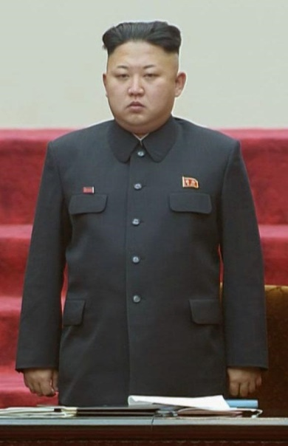
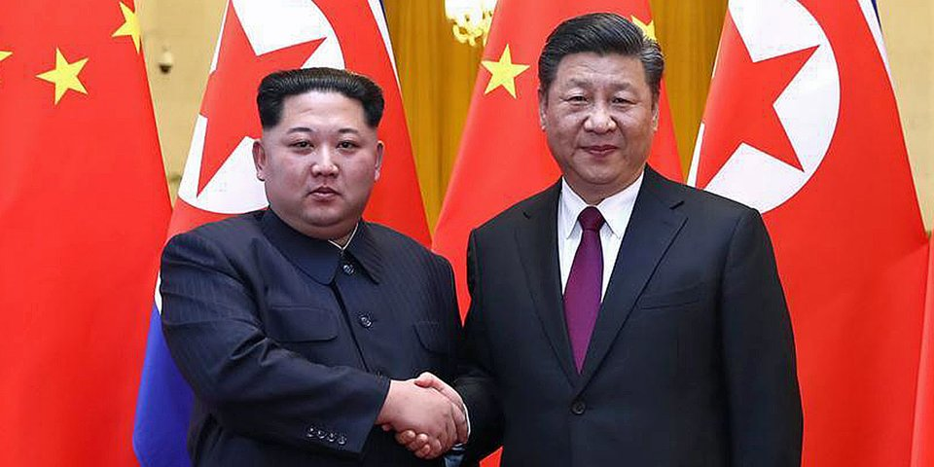
Ambitious/confident
Bold, competitive, and self-assured; easily assume leadership roles, expect others to recognize their special qualities, and may act as though entitled.
Notes:
North Korean leader Kim Jong Un stands during the April 9, 2014, session of the Supreme People's Assembly, the country's parliament, in Pyongyang. (Kyodo via AP Images)
At the invitation of Xi Jinping, general secretary of the Central Committee of the Communist Party of China (CPC) and Chinese president, Kim Jong Un, chairman of the Workers' Party of Korea (WPK) and chairman of the State Affairs Commission of the Democratic People's Republic of Korea (DPRK), paid an unofficial visit to China from March 25 to 28, 2018. During the visit, Xi held talks with Kim at the Great Hall of the People in Beijing. (Xinhua News / Ju Peng)

Slide 22
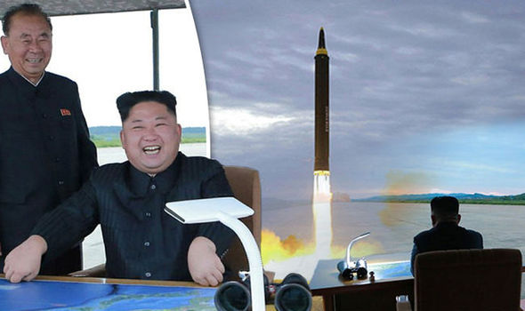
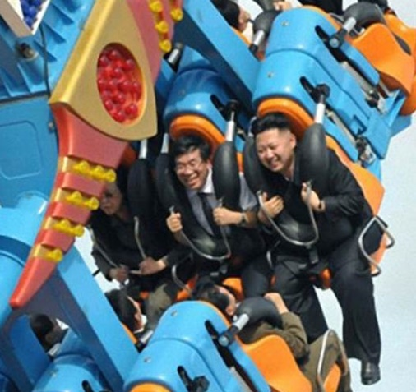
Dauntless/adventurous
Tend to flout tradition, conventional standards, and cultural mores, dislike following routine, and may act impulsively and recklessly; resistant to coercion and may exhibit a strong need for autonomy and self-determination.
Notes:
Kim Jong-un watches the launch of an intermediate-range ballistic missile (IBM) fired over Japan, Aug. 29, 2017. (KCNA via Reuters)
"Thrill seeker" -- North Korean leader Kim Jong Un enjoys a ride at the Rungna People's Pleasure Ground in Pyongyang in this image taken from the website of the state news agency on July 26, 2012. (KCNA via EPA)

