Slide 1
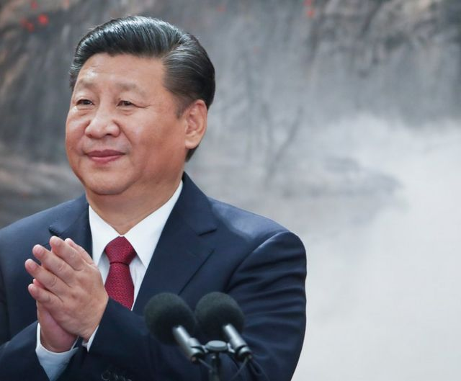
The Personality Profile and Leadership Style of China’s President
Xi Jinping
Aubrey Immelman and Yunyiyi Chen
Notes:
This presentation summarizes the results of an indirect assessment of the personality of China’s President Xi Jinping, from the conceptual perspective of personologist Theodore Millon. The data were synthesized into a personality profile using Immelman’s conceptual framework, derived from Theodore Millon’s model of normal personality types and their maladaptive variants.

Slide 2
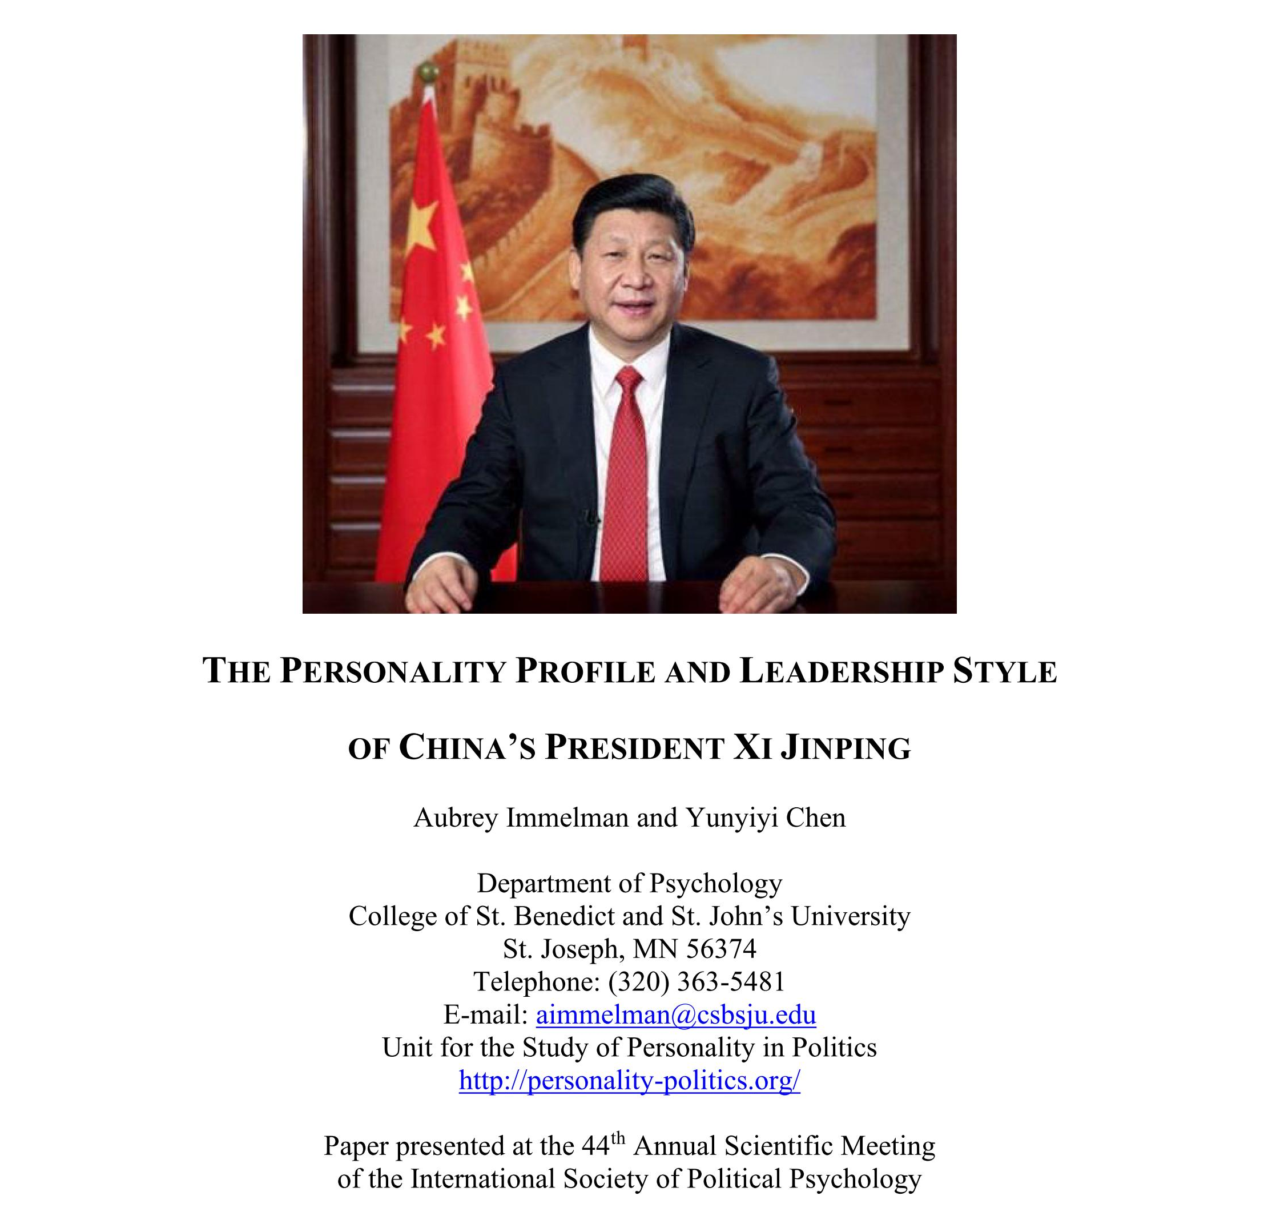
Notes:
This is a screen shot of the title page of the full-text research report of “The Personality Profile and Leadership Style of China’s President Xi Jinping,” which will be available for download from the College of St. Benedict and Saint John’s University institutional repository at Digital Commons in 2024 » https://digitalcommons.csbsju.edu/psychology_pubs/141

Slide 3
Personality, Inventory, and Research Method
What is
Personality?
Sources
Eight attribute domains
Twelve scales
Three gradations (levels)
Millon Inventory of Diagnostic Criteria
(MIDC)
Patterns of thinking, feeling, acting, and relating to others
Stability & consistency
Deeply embedded, largely nonconscious, and multifaceted
News articles
Scholarly papers
Biographies
Notes:
Personality: In our personality-in-politics research, we conceptualize personality as the distinctive, ingrained, pervasive patterns of thinking, feeling, acting, and relating to others that are relatively stable over time and consistent across situations. As such, personality is deeply embedded in the individual person, largely nonconscious, not easily altered, and typically expressed automatically in most facets of psychological functioning.
Inventory: For the present study, we employed an assessment methodology based on Theodore Millon’s model of personality types and their pathological variants, using a compilation of diagnostic criteria systematized in a personality taxonomy labeled the Millon Inventory of Diagnostic Criteria (MIDC). The MIDC encompasses 8 attribute domains, 12 personality scales, and several gradations (or levels) ranging from normal, adaptive patterns to more extreme and likely maladaptive variants.
Research method: In our at-a-distance assessment of personality, “psychodiagnostically relevant” data are collected from news reports and biographical sources. These extractions are coded for attribute domains, personality scale, and gradation. Upon completion of the data collection phase, each of the 170 diagnostic criteria are classified as affirmative, equivocal/affirmative, equivocal/negative, or negative.

Slide 4
Millon’s Eight Attribute Domains
A.
Expressive Behavior
B.
Interpersonal Conduct
C.
Cognitive Style
D.
Mood/Temperament
E.
Self-Image
F.
Regulatory Mechanisms
G.
Object Representations
H.
Morphologic Organization
Notes:
Our conceptual model comprises eight attribute domains of personality; however, assessment is limited to the five attribute domains (A through E) most amenable to observation, namely, expressive behavior, interpersonal conduct, cognitive style, mood/temperament, and self-image. Attribute domains F, G, and H (regulatory mechanisms, object representations, and morphologic organization) are omitted due to the difficulty of assessing those domains at a distance; however, they can be inferred based on the principle of theoretical coherence. For example, if a leader possesses the expressive behavior, interpersonal conduct, cognitive style, mood/temperament, and self-image of a narcissist, it can be assumed that he or she also has the defense mechanisms, object relations, and ego strength associated with narcissism. This has profound practical implications because it permits insight into personality attributes that cannot be directly observed or captured by at-a-distance, indirect personality assessment.

Slide 5
Millon Inventory of Diagnostic Criteria
Taxonomy: Scales and Gradations
1A
1B
2
3
4
5A
Dominant
Dauntless
Ambitious
Outgoing
Accommodating
Aggrieved
Asserting
Controlling
Aggressive
Adventurous
Dissenting
Aggrandizing
Confident
Self-serving
Exploitative
Congenial
Gregarious
Impulsive
Cooperative
Agreeable
Submissive
Unpresuming
Self-denying
Self-defeating
5B
6
7
8
9
0
Contentious
Conscientious
Reticent
Retiring
Distrusting
Erratic
Unpresuming
Self-denying
Self-defeating
Respectful
Dutiful
Compulsive
Circumspect
Inhibited
Withdrawn
Reserved
Aloof
Solitary
Suspicious
Paranoid
Unstable
Borderline
Notes:
The MIDC operationalizes Millon’s conceptual framework of personality into 12 categories. Each of the 12 scales (i.e., personality patterns) is subdivided into two or three gradations (or levels), giving the inventory a dimensional component. Scores at the low end of the pattern (level a) signify normal, adaptive levels of a pattern, whereas scores at the high end (level c) signify personality dysfunction. Scales 9 and 10 (levels c and d) represent more severe personality disturbances and have no normal variants.

Slide 6
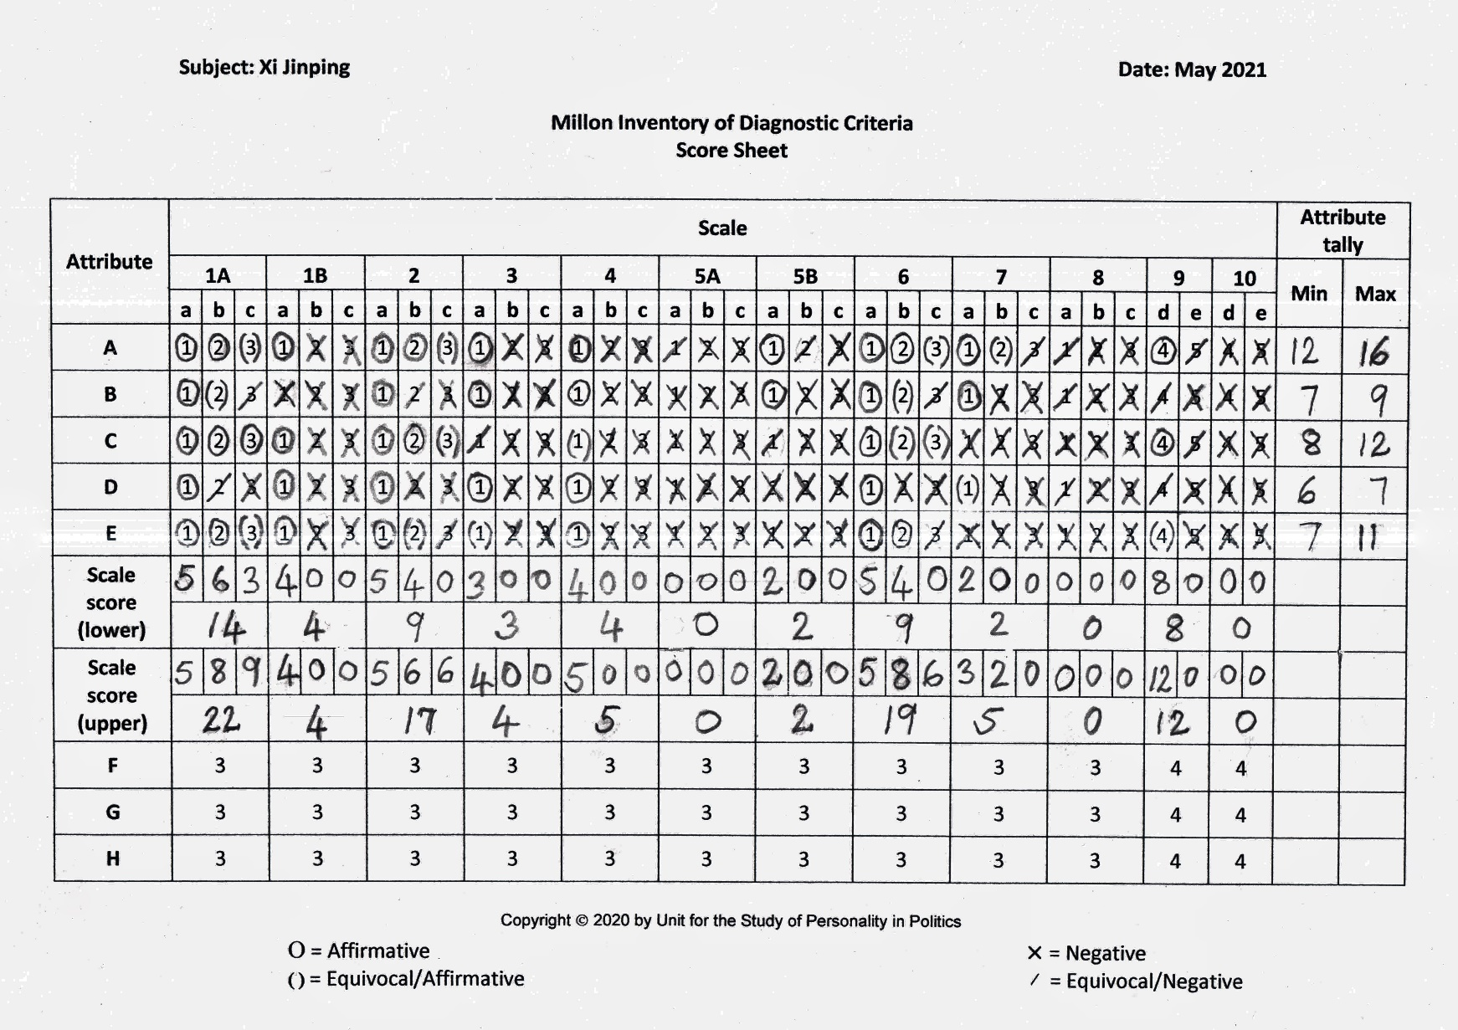
MIDC Score Sheet for Xi Jinping
Notes:
The MIDC score sheet for Xi Jinping summarizes more than 400 pages of data collected from 350 unique sources over a two-year period. Diagnostic criteria classified as affirmatively present, based on psychodiagnostically relevant data extracted from open sources in the public domain, are circled. Equivocally present diagnostic criteria are placed in parentheses. Diagnostic criteria without empirical support are crossed out and equivocally absent criteria are marked with a slash. The scoring procedure concludes with the identification of primary, secondary, and subsidiary scale elevations.

Slide 7
MIDC Item Endorsement Rate by Attribute Domain
 |  | Diagnostic criteria (Items)
Attribute domain |  | Present |  | Possible
Expressive behavior |  | 12 |  | 16
Interpersonal conduct |  | 7 |  | 9
Cognitive style |  | 8 |  | 12
Mood/temperament |  | 6 |  | 7
Self‑image |  | 7 |  | 11
Sum |  | 40 |  | 55
Mean |  | 8.0 |  | 11.0
Standard deviation |  | 2.1 |  | 3.0
Notes:
This table shows the MIDC item endorsement rate by attribute domain. The column labeled “present” displays the tally of items classified as affirmatively present and column labeled “possible” displays the tally of items classified as affirmatively present, plus the tally of items classified as equivocally present. We found between 6 and 12 affirmatively present diagnostic criteria for each of the five attributes, with a mean of 8 and a standard deviation of 2.1. We found the most affirmative data for the attribute domain of expressive behavior, which is relatively easy to assess at a distance. Data on mood/temperament proved to be the most elusive.

Slide 8
MIDC Scale Scores
Scale | Personality pattern | Lower | Upper
1A | Dominant: Asserting–Controlling–Aggressive (Sadistic) | 14 | 22
1B | Dauntless: Adventurous–Dissenting–Aggrandizing (Antisocial) | 4 | 4
2 | Ambitious: Confident–Self-serving–Exploitative (Narcissistic) | 9 | 17
3 | Outgoing: Congenial–Gregarious–Impulsive (Histrionic) | 3 | 4
4 | Accommodating: Cooperative–Agreeable–Submissive (Dependent) | 4 | 5
5A | Aggrieved: Unpresuming–Self-denying–Self-defeating (Masochistic) | 0 | 0
5B | Contentious: Resolute–Oppositional–Negativistic (Passive‑aggressive) | 2 | 2
6 | Conscientious: Respectful–Dutiful–Compulsive (Obsessive‑compulsive) | 9 | 19
7 | Reticent: Circumspect–Inhibited–Withdrawn (Avoidant) | 2 | 5
8 | Retiring: Reserved–Aloof–Solitary (Schizoid) | 0 | 0
 | Subtotal for basic personality scales | 47 | 78
9 | Distrusting: Suspicious–Paranoid (Paranoid) | 8 | 12
0 | Erratic: Unstable–Borderline (Borderline) | 0 | 0
 | Full-scale total | 55 | 90
Notes:
This table displays Xi Jinping’s scale scores for each of the 12 personality patterns. The column labeled “lower” represents the number of items classified affirmative and the column labeled “upper” shows the number of items classified as affirmative, plus those classified as equivocally present. The lower- and upper-bound scores analogous to confidence intervals in statistics.

Slide 9
MIDC Profile for Xi Jinping
Notes:
This is a graphic representation of the MIDC profile for Xi Jinping. In this graph, the blue bar represents the baseline scores of affirmative classifications for each scale (i.e., the lower limit), while the red bar signifies “ceiling” scores based on affirmative plus equivocally affirmative classifications (i.e., the upper limit). The range between the lower limit (blue bar) and upper limit (red bar) is akin to a confidence interval. The colored horizontal lines represent the cutoff elevations for the gradations into present, prominent, and dysfunctional levels.
Xi Jinping’s primary personality pattern is the scale 1A dominant pattern, with a scale elevation in the “prominent” range. Xi obtained secondary elevations on the scale 6 conscientious pattern and the scale 2 ambitious pattern in the “present” range and equivocal subsidiary elevations on the scale 4 accommodating and scale 7 reticent patterns.
With his primary Dominant/controlling pattern (a measure of aggressiveness) and his secondary Conscientious/dutiful and Ambitious/self-serving patterns (the latter a measure of narcissism), Xi’s profile may be characterized as that of a “high-dominance conformist.”

Slide 10
Xi Jinping’s Basic Personality Patterns
Primary Personality Pattern
01
Dominant/controlling
Forceful
Aggressive
Tough
Unsentimental
Secondary Personality Pattern
02
Conscientious/respectful–dutiful
Dutiful
Diligent
Attentive to details
More technocratic than visionary
Secondary Personality Pattern
03
Ambitious/confident–self-serving
Bold
Competitive
Optimistic
Self-assured
Notes:
The pie chart represents the relative ratios of the 10 basic personality patterns in Xi Jinping’s overall personality configuration. The personality pattern accounting for the largest proportion of the total personality “variance” (i.e., composite personality configuration) is the dominant pattern, followed by the ambitious, conscientious, accommodating, dauntless, and outgoing patterns. The primary and secondary personality patterns are discussed in greater detail in subsequent slides.

Slide 11
Primary Personality Pattern

1A
Level b
Enjoy the power to direct others and to evoke respect
Tough, outspoken, unsentimental, and unyielding
Forceful, controlling and closedminded
Power-oriented tendencies evident in occasional intransigence
Typically make effective leaders
Dominant
(forceful, aggressive)
Notes:
Xi Jinping’s primary personality pattern – scale 1A, dominant – reflects his forceful, aggressive tendency. Dominant individuals enjoy the power to direct others and evoke obedience and respect; they are tough and unsentimental and often make effective leaders.

Slide 12
Secondary Personality Pattern

Dutiful and diligent
Strong work ethic and careful attention to detail
Loyal to political party and causes
Persistent in difficult circumstances
Formal, proper, and dignified
Hold strong moral principles and absolute certainty
Intolerant of deviance
6
Level a
Conscientious
(respectful, conforming)
Notes:
Xi Jinping’s most distinctive secondary personality pattern – scale 6, conscientious – reflects in his tendency to be dutiful and diligent. Conscientious individuals have a strong work ethic with careful attention to detail and often excel in crafting public policy, though they tend to be more technocratic than visionary. They are civil, respectful, and dignified in their interpersonal relationships and may at times appear excessively formal and proper. They are loyal to their political party and causes, tend to hold strong moral principles and absolute certainty, and are persistent in the face of adversity. Moreover, conscientious people have a lower tolerance for deviance than most.

Slide 13
Secondary Personality Pattern

2
Level a
Bold, competitive, self-assured, and optimistic
Self-confident; believe in themselves and their talents
Ambitious; achievement oriented
Skilled at using charm to persuade others
Expect others to recognize their special qualities
May act as though entitled
Ambitious
(egocentric, narcissistic)
Notes:
Xi Jinping’s behavior is also influenced by a secondary ambitious – scale 2 – pattern, reflecting his predisposition to be bold, competitive, and resilient in the face of adversity. Ambitious individuals are self-assured; easily assume leadership roles, expect others to recognize their special qualities, and sometimes act as though entitled. This scale is an index of narcissism. Notably, however, Xi’s scale elevation is not in the pathologically narcissistic range.

Slide 14
Subsidiary Personality Patterns

Cordial, cooperative, and amicable
Willing to adapt preferences to be compatible with those of others
Motivated to reconcile differences to avoid conflict
Concede or compromise when necessary
4
Level a-

1B
Level a-
Accommodating
(agreeable, conciliatory)
Flout tradition and conventional standards
Dislike following routine and may act impulsively
Resistant to coercion; strong need for independence
Dauntless
(risk-taking, unprincipled)
Notes:
Xi Jinping’s two subsidiary scale elevations potentially yield insights into likely political behavior as a negotiation partner and may also have implications with respect to threat assessment in terms of the national security interests of adversarial nations. Xi’s modest elevation on the accommodating scale 4 suggests that he has the potential to be agreeable and cooperative if “the price is right,” so to speak. Agreeable individuals are cordial, cooperative, and amicable. They are motivated to reconcile differences to avoid conflict and are willing to adapt preferences to be compatible with those of others.
The scale 1B dauntless pattern – the polar opposite of conscientiousness – reflects a leader’s predisposition to sensation seeking – for example, military adventurism. Dauntless leaders are prone to flouting tradition, dislike routine and may on occasion act impulsively. They are independent and resistant to coercion.
For both subsidiary personality patterns depicted on this slide, Xi exhibits a level slightly below, though approaching, the “present” threshold at level a.

Slide 15
Leadership Implications
Leadership Style
(Simonton, 1988)
Leadership skills
(Renshon, 1996)
Deliberative: well informed; exhibit depth of comprehension; able to visualize alternatives and weigh long-term consequences; understand the implications of their decisions; cautious and emotionally controlled
Orchestration: Strong organizational skills in conjunction with the sustained focus and the attention to detail necessary for policy formulation
Foreign policy orientation
(Etheredge, 1978; Hermann, 1987)
Presidential temperament
(Barber, 1965; 1972/1992)
High-dominance introvert: stubborn, tenacious; tend to dichotomize the world in terms of moral good vs. evil; seek to reshape the international system in accordance with their personal vision; foreign policy characterized by the tenacity of advancing one central idea; preoccupied with establishing institutions or principles to keep potentially disruptive forces in check
Expansionist: view of the world as being divided into “us” and “them,” based on a belief system in which conflict is viewed as inherent in the international system
Doubtful that Barber’s model applies to China’s political system, but hypothetically active-negative: more energy invested (i.e., active) than enjoyment derived (i.e., negative) from political office (compulsive quality to governing)
Pragmatist: active-negative “advertiser” motivated by power seeking (possibly to compensate for low self-esteem); driven by self-enhancement and self-promotion
Notes:
The level of detail in the content of this slide is self-explanatory.

Slide 16
Leadership Implications (continued)
Leadership trait analysis
(Hermann, 1987, 2003)
Worldview
Personal style
Foreign policy behavior
World divided into “us” and “them”; belief system in which conflict is viewed as inherent in the international system
Wary of others’ motives; directive, controlling interpersonal orientation
Focused on issues of security and status, favoring low-commitment actions and espousing short-term, immediate change in the international arena
Challenges constraints; closed to information; task-oriented = Advocate (expansionistic) type – focus on expanding the leader’s, the government’s, and the state’s span of control and sphere of influence
Notes:
The level of detail in the content of this slide is self-explanatory.

Slide 17
Conclusions
Leadership strengths
Leadership limitations
Strong, authoritative leader
Conscientious; detail-oriented ability to formulate and craft specific policies
Confident; self-assured, ambitious; believe in themselves and their talents
Disdain for social interaction; possible deficit in important political skills crucial for mobilizing and retaining popular support
Self-defeating potential for dogmatically pursuing personal policy preferences despite public, legislative, or international disapproval
Website:
Unit for the Study of Personality in Politics (uspp)
Notes:
The level of detail in the content of this slide is self-explanatory.

Slide 18
Thanks!
Immelman, A., & Chen, Y. (2021, July). The personality profile and leadership style of China’s President Xi Jinping. Collegeville and St. Joseph, MN: St. John’s University and the College of St. Benedict, Unit for the Study of Personality in Politics. (Paper presented at the 44th Annual Meeting of the International Society of Political Psychology, July 11–13, 2021.) Full-text paper will be available for download from the College of St. Benedict and Saint John’s University institutional repository at Digital Commons in 2024: https://digitalcommons.csbsju.edu/psychology_pubs/141
Notes:
Immelman, A., & Chen, Y. (2021, July). The personality profile and leadership style of China’s President Xi Jinping. Paper presented at the 44th Annual Meeting of the International Society of Political Psychology, July 11–13, 2021. The full-text paper will be available for download from the College of St. Benedict and St. John’s University institutional repository at Digital Commons in 2024: https://digitalcommons.csbsju.edu/psychology_pubs/141

